Slide 1

CARS DATABASE
Notes:
Let’s start by looking at the Cars Database

Slide 2
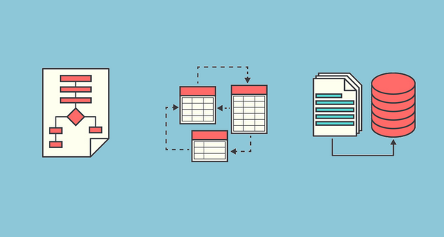

OVERVIEW
RELATIONAL MODEL DESIGN
FUTURE OF THE DATABASE
ENTITY RELATIONSHIP MODEL DESIGN
PERFORMANCE ENCHANCEMENT
Notes:
Under this section, we will discuss the Entity Relationship Model design, it’s conversion into relational model, performance enhancement techniques and the future of the database

Slide 3

ENTITY RELATIONSHIP MODEL
Notes:
Entity Relationship Model

Slide 4
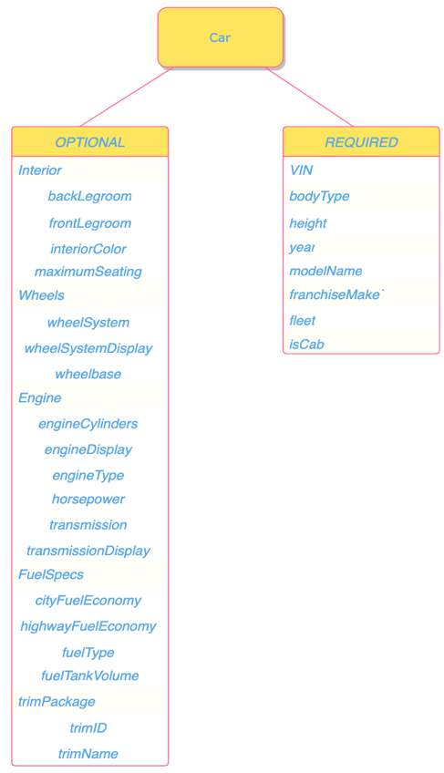
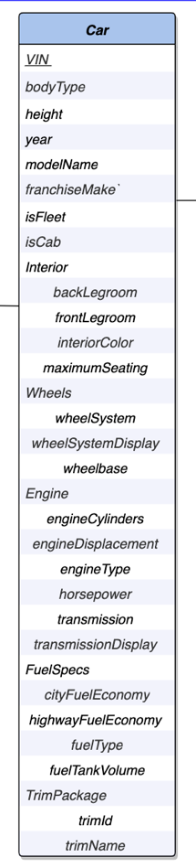
CARS entity
Optional and Required attributes
Entity sets vs. Attributes
Notes:
On the Left is Cars entity, right is the categorization of its attributes into optional and required.
Motivation behind categorizing these attributes as optional:
When we say Car exists in our database, we mean it exists in Plato’s world. In real world, a car must have an engine but that doesn’t mean we expect that every dealer attempting to sell their car would know the engine cylinder specifications. Setting these lesser commonly knows specs of the entity as optional allowed us to reduce the number of NULL in our database
We opted for bodyType, Interior etc. to be single-valued composite descriptive attributes rather than entities because the items under consideration are best described as an adjectives of the car rather than a nouns

Slide 5
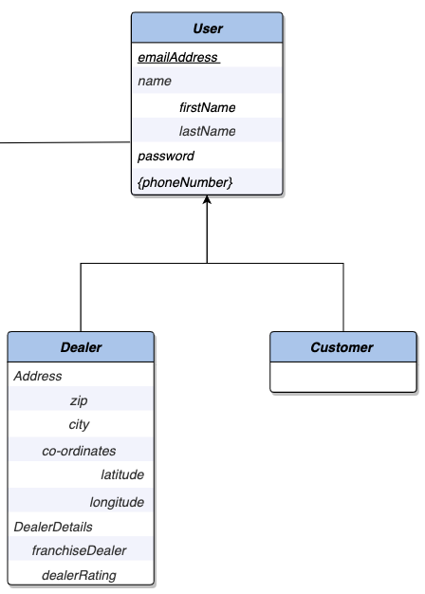
USER entity
HIGHER-LEVEL ENTITY
LOWER-LEVEL ENTITIES
Partial Disjoint Generalization
Keys
Dealer Attributes
Notes:
Motivation behind using Specializations, Our database currently designed to be used by a single application but we expect many more types of users like data science analysts, marketing analyst, HR, Legal etc., to use our database in the future. We felt like using a specialization was a good strategy compared to using ROLES because attributes like dealerRating don’t apply to customers and using a NULL would represent N/A which is just bad database design. Moreover, we can add more lower-level entities with backwards compatibility in this model with little to no effort.
Choosing emailAddress as primary key: Our database does not restrict multiple users from having the same name and a single user from storing multiple phoneNumbers, by virtue of using the complete email address with the domain name we are by design enforcing the uniqueness of that attribute.
For example, if we send an email to only your uwaterloo email address then we can safely assume that you are the only intended recipient of that email.

Slide 6
Dealer Attributes
Notes:
Within the dealer attributes, Address is a single valued composite attribute with a mixture of single valued attributes and a composite attribute. We have made the Address optional to accommodate dealers who might not feel comfortable with sharing personal details in the listing

Slide 7
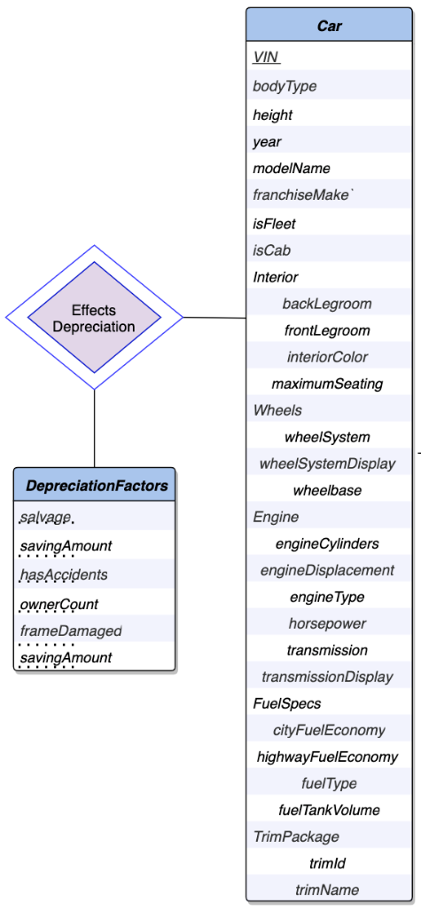
Depreciation Factors Entity EffectsDepreciation Relationship Set
Cardinality
Car has 0:1
DepreciationFactors has 0:1
Notes:
The existence of DepreciationFactors that EffectsDepreciation of the Car entity has no meaning. The former is predicated on the existence of the latter.
the primary key of a weak entity set is the combination of the primary key of the entity upon which it is dependent
Car has a 0:1 cardinality, it can be in the relation one time and DepreciationFactors has 0:1 cardinality, you can have one set of factors effecting a car’s valuation or none, can’t have multiple values for the same factors hence it can be in the relationship only once

Slide 8
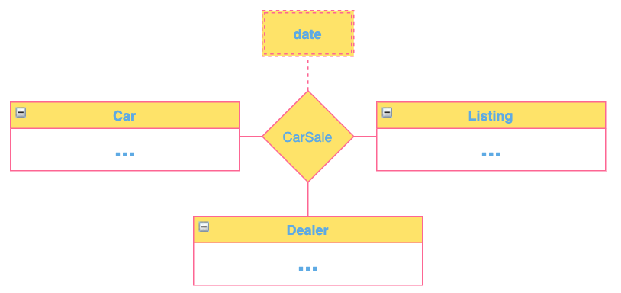
CarSale Relationship Set
1:1
1:*
1:1
1:1
1:1
1:*
Notes:
Car, Listing, User entities are in a ternary relation with CarSale as the relationship set. ‘date’ is a descriptive attribute linked to this relation; it refers to the date a Listing was made by Dealer for the sale of a Car. The ‘date’ is a simple single-valued attribute.
Instead of creating multiple binary relations, we have opted here to use the more effective and information preserving ternary relation because it enforces that they are all connected.
[key] Car:Listing is (1:1); Listing:Car is (1:1) i.e., compulsory participation is enforced on both entities, and they are exclusively and uniquely mapped to each other
[key] Dealer:Car is (1:*); Car:Dealer(1:1) because a Dealer must attempt a car sale to be in the relation but can sell as many Cars as they want, while a Car can only be sold by a single Dealer
[key] Listing:Dealer is (1:1); Dealer:Listing is (1:*) because for a dealer to be in the system they must create a Listing but may have more than one and a Listing can have exactly one Dealer based on our application scope

Slide 9
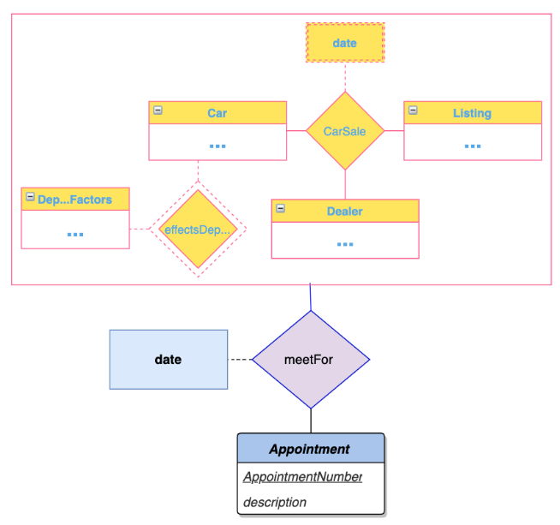
- meetFor relationship set - Appointment entity set - Aggregate entity
Notes:
Relationship sets meetFor and CarSale represent overlapping information. Every meetFor relationship ties together a Car, Listing, Dealer just like CarSale but we cannot remove CarSale since it can exist without any meetings. In addition, we have some extra attributes like description related to the ‘meet’ called Appointment here
Our aggregate entity is within the pink rectangle with our CarSale relation and the whole thing is connected to our meetFor relation connecting Appointment entity (with ‘date’ as descriptive attribute) to the aggregate entity

Slide 10
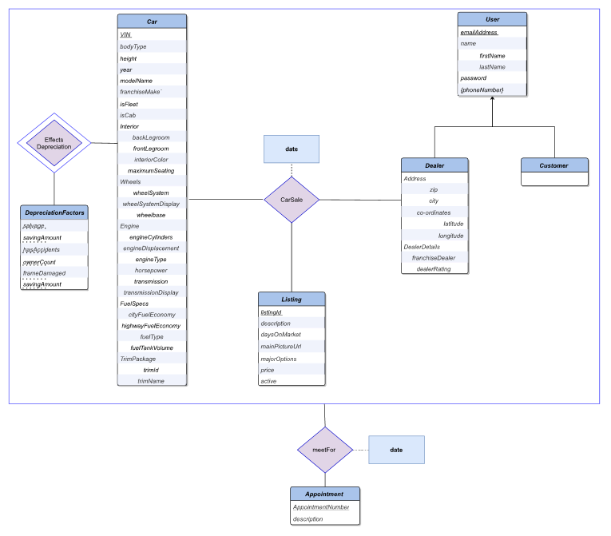
Final Entity Relationship Model
(saved in ERD-Final.pdf)
Notes:
This is our final Entity Relationship model; you can find the high-definition diagram in the report and our git repo

Slide 11
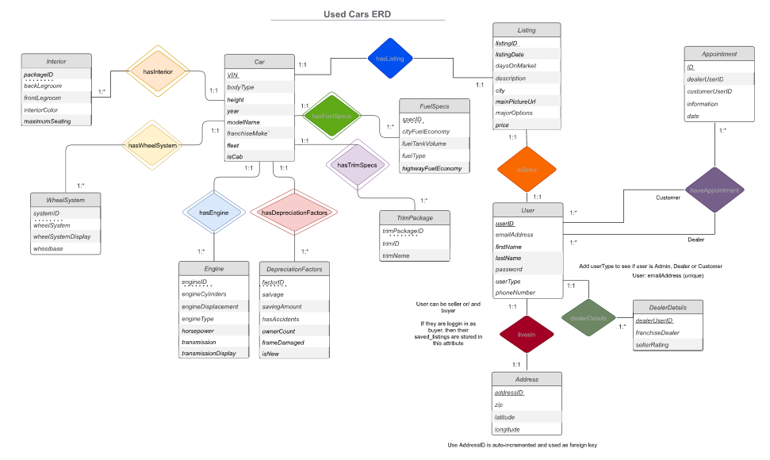
Alternate Design Choices
Notes:
This ER diagram is an amalgamation of all the alternate design choices we considered before finalizing our ER model.
As discussed briefly earlier, we opted to make the weak entity sets in this ER diagram, optional composite attributes in our current Car entity. Before we understood the significance of having well defined primary keys and coming across the disadvantages of using auto-incremented primary keys that are referenced with foreign keys, we planned on using packgeID, systemID etc. which would have made our database more error prone and deletion of table entries and adjustment of auto-incremented keys more complicated.
You can also notice that in this draft, the ternary relation, CarSale is split into a binary relationship here. The problem with this model is that information that although Car and Listing are connected and Listing and User are connected, The fact that a single dealer is associated with the sale of a car is lost. As mentioned earlier our ternary relationship captures this relationship by connecting all the entities that are involved in the car sale. The same thing can be said about the lack of an aggregate entity that comprises this relationship connecting Appointment entity.
Finally, you can notice the addition of specialization of Users entity and addition of descriptive attributes to relationship sets.

Slide 12
ER-MODEL TO RELATIONAL MODEL
Notes:
That that we have our ER model, we can proceed to convert it into a relational model

Slide 13

Relational Model for optional attributes in Cars
Cars(VIN, bodyType, height, year, modelName, franchiseMake, isFleet, isCab)
Interior(VIN, backLegroom, frontLegroom, interiorColor, maximumSeating)
Wheels(VIN, wheelSystem, wheelSystemDisplay, wheelbase)
Engine(VIN, engineCylinders, engineDisplay, engineType, horsepower, transmission, transmissionDisplay)
FuelSpecs(VIN, cityFuelEconomy, highwayFuelEconomy, fuelType, fuelTankVolume)
TrimPackage(VIN, trimID, trimName)
Notes:
Now our primary concern with the datasets on Kaggle was all the large number of NULLs and empty strings. By understanding the database and our applications usage we decided to create our entity and relational sets in such a way that the nulls are minimized, and they only have one connotation, missing information and not N/A
Let’s look at one of the optional single-valued composite attributes, relation is going to be called Interior with all the single-valued simple attributes as part of its relation and with VIN as the primary key to identity the specific car it related to
Another concern while converting ER to Relational model is to reduce ambiguity and as a result reduce the possibility of error, so we have different integrity constraints unique, check, not null etc. along with foreign keys referencing VIN in the User table on attributes based on their domain

Slide 14
User, DealerDetails, Customer Relational Schema
PRIMARY KEY for User, DealerDetails, Customer: emailAddress
FOREIGN KEY references to emailAddress in User from lower-level entities
After NORMALIZATION, Address and Coordinate relational schemas are creating splitting the composite attribute Address from Dealer
Dealer re-named to DealerDetails for clarity
Notes:
We performed Top-Down Specialization to convert it into relational model.
All of the schemas will have emailAddress as primary key and the lower level schemas will will have foreign key references to User(emailAddress)
For the higher-level entity User, that has both simple composite attribute like name and a multivalued attribute like phoneNumber. We condensed name into the relational schema, and for phoneNumber we create a separate phone number schema selecting a primary key such that a single use can have multiple phoneNumbers.
Our Dealer entity has Address which was deemed optional, it’s a composite attribute with single valued simple attribute and a composite attribute within. If we were to just create an Address schema with zip, city , latitude and longitude it would not be BCNF compliant. So we split address into two schemas – One just called Address that would contain zip, city and another called Co-ordinates that would contain the latitude and longitude.
For clarity, we name the Dealer Model DealerDetails cuz currently it just has these two attributes.

Slide 15

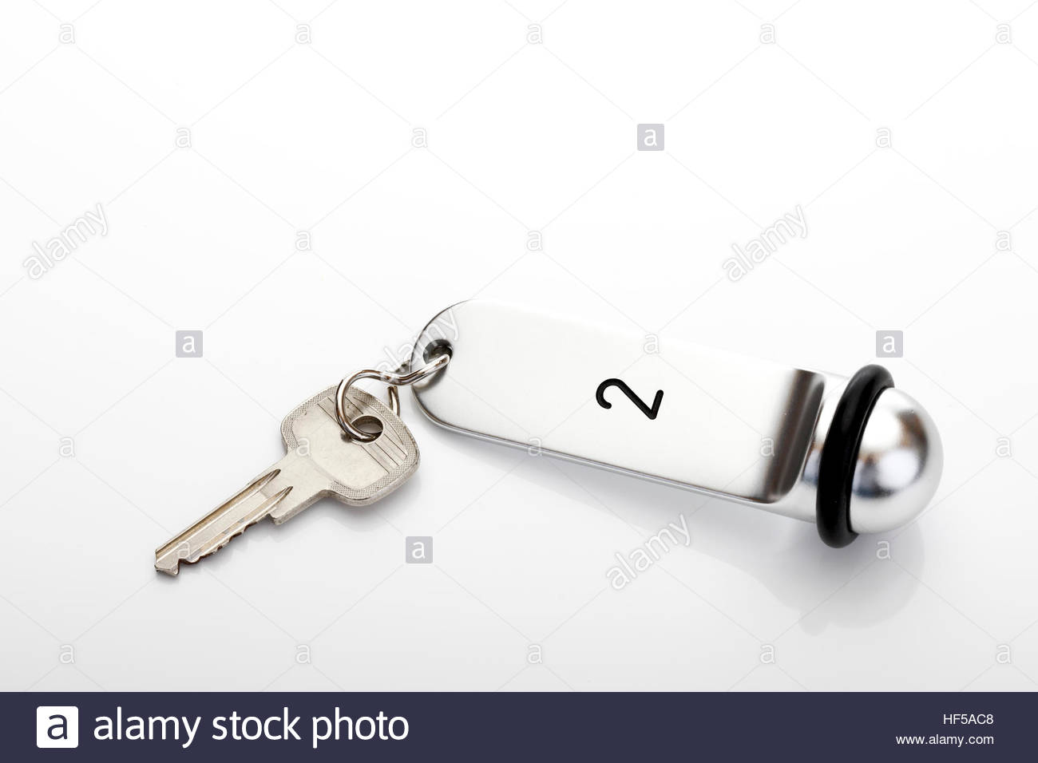

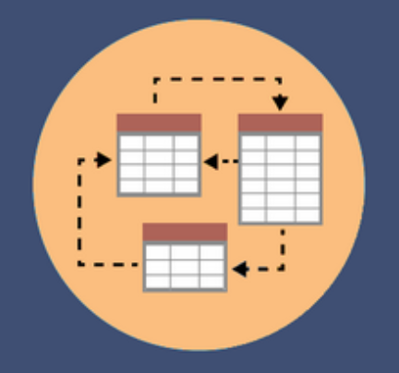
CarSale Relationship Set
OPTION 1
OPTION 2
OPTION 3
OPTION 4
CarSale
(emailAddress, VIN, listingId, date)
CarSale
(VIN, listingId, emailAddress, date)
Cars(VIN, listingId, …)
Listing(listingId, dealerEmail, listingDate, …)
Cars(VIN, listingId)
CarSale(listingId, dealerEmail, date)
Notes:
Finally, we will discuss our process for enforcing the CarSale Relationship in our database.
And three of them require creating a separate relation like CarSale, but OPTION 3 considers the cardinality constraints we talked about in the ER Model, Listing and Dealer have a 1:1 relationship, CarSale serves no special purpose
Therefore, we opted to add the ListingId to cars and dealerEmail to Listing with the date attribute renamed as listingDate to avoid any conflicts all connected through foreign key constraints
Option 1 and 2 use a separate car sale relation but just differ in their primary keys. In the 4th Option, there is no VIN in CarSale relation, so we connect listingId to car sale and foreign key constraints enforce the ternary relation

Slide 16
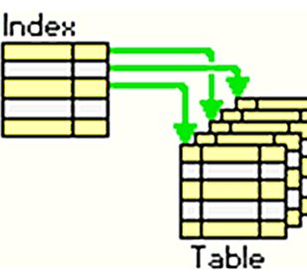
Performance Enhancement
Notes:
In this section, we will look at some other indexes added to improve the execution time of our queries to improve the applications performance as the number of records increase.

Slide 17
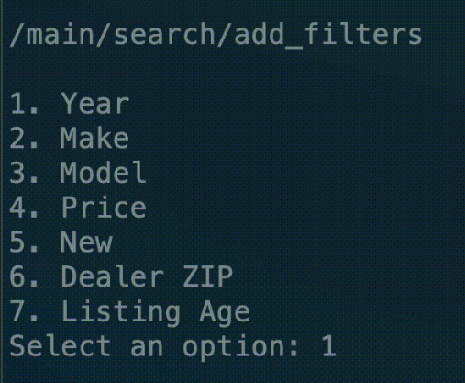
REDUCING THE LENGTH OF ATTRIBUTES
power
RPM
torque
legroom
front
Legroom
back
Legroom
FILTERS
Notes:
Our application is defined to use several filters allowing the users to find cars that suite their needs instead of browsing through the 3 million listings in our database. Some strategically added indexes were able to decrease the execution time on queries that need to perform a lot of joins.
To decrease the size of joint attributes in the dataset and increase the efficiency of lookups, we also split the fuel economy into cityFuelEconomy and highwayFuelEconomy.
We saw an improvement in the range of 40-65% after adding these indexes to our database with just primary and foreign keys.

